Slide 1
Data science group project
Nhung (Kristen) Nguyen, Aryan Tamrakar, Raegan Herdman​​

Slide 2
Justifications​
How does psycho social factors of a patient affect their treatment outcome by relapse and survival rate ?
- Negative affective disorders like depression or anxiety due to social factors put patients at risk for worse health outcomes, lengthier hospital stays, and increased mortality.
- An eight percent longer length of stay following transplantation was linked to the presence of any general mood, anxiety, or adjustment disorder. An increased need for counseling is substantially predicted by poor transplant functioning.​ (Cooke et al.)
- Psychiatric disturbance with social-related factors have been proven to affect the outcomes of medical treatments on patients with diabetes and hypertension, as well as other chronic illnesses. (Herrera et al.)
​
- . Similarly, cancer patients reporting symptoms of psychological stress (symptoms of depression and anxiety), have higher rates of cancer-specific mortality. (Wang et al.) ​
​

Slide 3
Our Well-Defined problems
01
02
03
​
How does race(Racegp), education status(educ_stat), income(income_zip) affect survival rate (dead)?
How does psychiatric disturbance affect treatment related morbidity & disease free survival rate, and does that data align with predicted success from hctcigp?​
Do psychiatric disturbance (psychipr) and relaspe conditions relapse history (rel) and death due to treatment (trm) affect the interval between transplant and survival date (intsxurv) ?

Slide 4
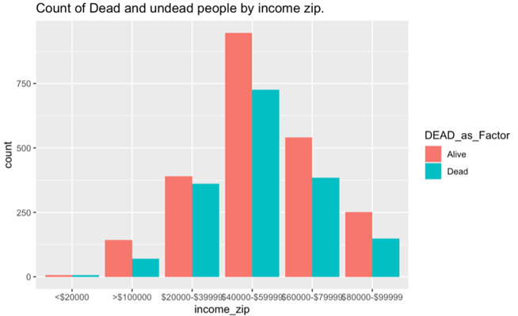
Question 1 EDA
Key takeaways :
The location with less than $20000 income had the least cases but the proportionality of Alive and dead seems to be at the same level.​
The location with income $20000 - $39999 had the dead and alive proportionality closest compared to other. ​
The number of cases seems to have peaked at the income location of $40000 - $59999. ​
The location with the income more than $100000 had the lowest death rate compared to other income levels. ​
​

Slide 5
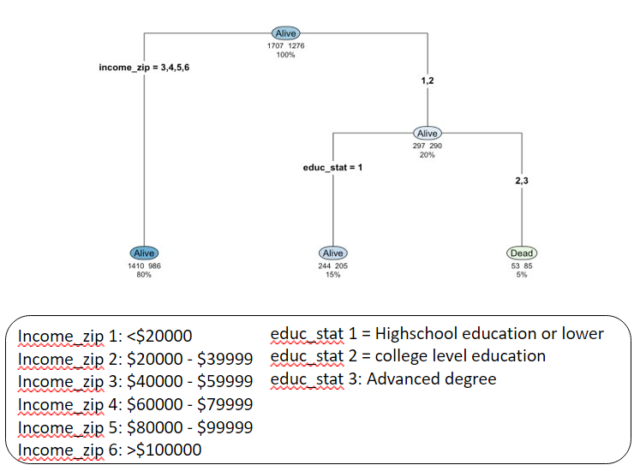
Question 1 Modelling
Key takeaways :
If the person is from the income_zip 3,4,5 and 6 which is the people from location where the income is more than $40000 will not die regardless of their education status with 80% chance​
​
If the person is from income_zip 1,2 (income of less $20000 and income from $20000 to $30000) and if they have education level 2 and 3 (college level education and advanced degree), they have higher chance dying from the disease. ​
​

Slide 6
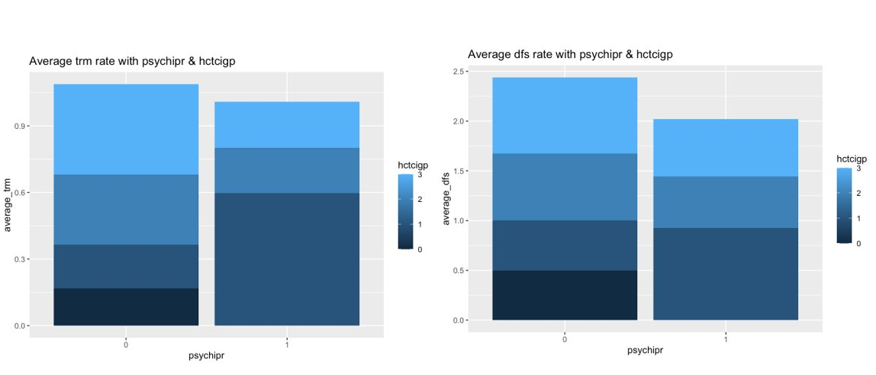
Question 2 EDA

Slide 7
Question 2 Modelling

Slide 8
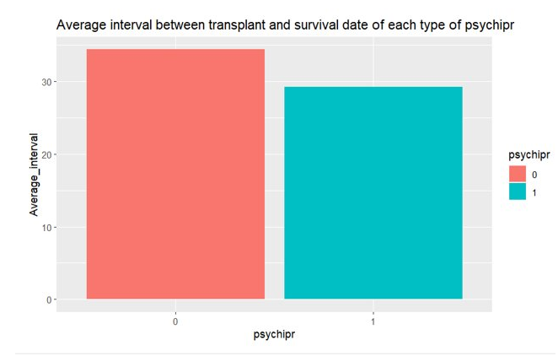
Question 3 EDA
Key takeaways :
The average survival interval of those who does not have psychiatric disturbance is higher than that of type 1 by approximately 10 units​
​
The average survival of psychipr type 0 approximately 41, while that of type 1 is approximately 29.​
​

Slide 9
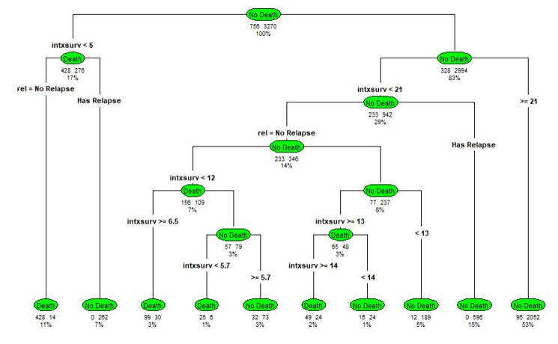
Question 3 Modelling
Key takeaways :
-> The most important variable based on the variable importance plot is the interval between transplant and survival date (intxsurv).​
​The tree has 10 subsets, with the most percentage (53%) of No Death​
​The majority outcome if intsxurv is lower than 21, whether there is relapse or no relapse, is No Death​
​If intxsurv is lower than 5, and there is no relapse, the percentage of Death is 11%, if there is relapse, the percentage of Death is 7%​
​

Slide 10
Joint conclusion :
There is more probability that the people with income more than $40000 will not die compared to the probability of people with less income than $40000 regardless of their education level. ​
People who do not have psychiatric disturbance, on average, has a longer interval between transplant and survival date than those who do.​
Lower values of interval between transplant and survival date (intxsurv) are generally associated with a higher likelihood of no death. When intxsurv is very low (below 5), the risk of death increases, especially in the absence of relapse.​
This does answer our collective question that psycho-social factors do affect treatment outcomes by relapse and survival rate.​

Slide 11
References
Cooke, L. (2009, May 1). Psychological consequences of HEMATOPOIEITC Stem Cell Transplant. Seminars in oncology nursing. ​
Herrera PA, Campos-Romero S, Szabo W, Martínez P, Guajardo V, Rojas G. Understanding the Relationship between Depression and Chronic Diseases Such as Diabetes and Hypertension: A Grounded Theory Study. Int J Environ Res Public Health. 2021 Nov 19;18(22):12130. doi: 10.3390/ijerph182212130. PMID: 34831886; PMCID: PMC8618720.​
Wang, YH., Li, JQ., Shi, JF. et al. Depression and anxiety in relation to cancer incidence and mortality: a systematic review and meta-analysis of cohort studies. Mol Psychiatry 25, 1487–1499 (2020). https://doi.org/10.1038/s41380-019-0595-x​
​

